Slide 1
Goodreads
Recommendation System
Team 10 TechEagle
Nigel Wang, Susie Li, Jennifer Kim, Faustin Nzitonda

Slide 2
Overview
Goodreads is one of the largest social cataloging website that allows readers to do complimentary database search that provides free reviews and book recommendation
Business Problem:
Create a database for Goodreads
Draw insights from the book data and user data
Build a recommendation system based user reviews by NLP
Analysis Tools:
S3, Python, PySpark, Hive, and Power BI

Slide 3
Data Ingestion
Comprises of 1.18 GB of Goodreads book database
Book Dataset: contains 17 ~ 20 columns;
Includes information on the book including title, author, ISBN, page number, publish date, description, and rating of corresponding book including count of rating and review
User Rating Dataset: contains 3 columns;
includes user ID, book title, and review rating
Total: 30 datasets with 462 columns

Slide 4
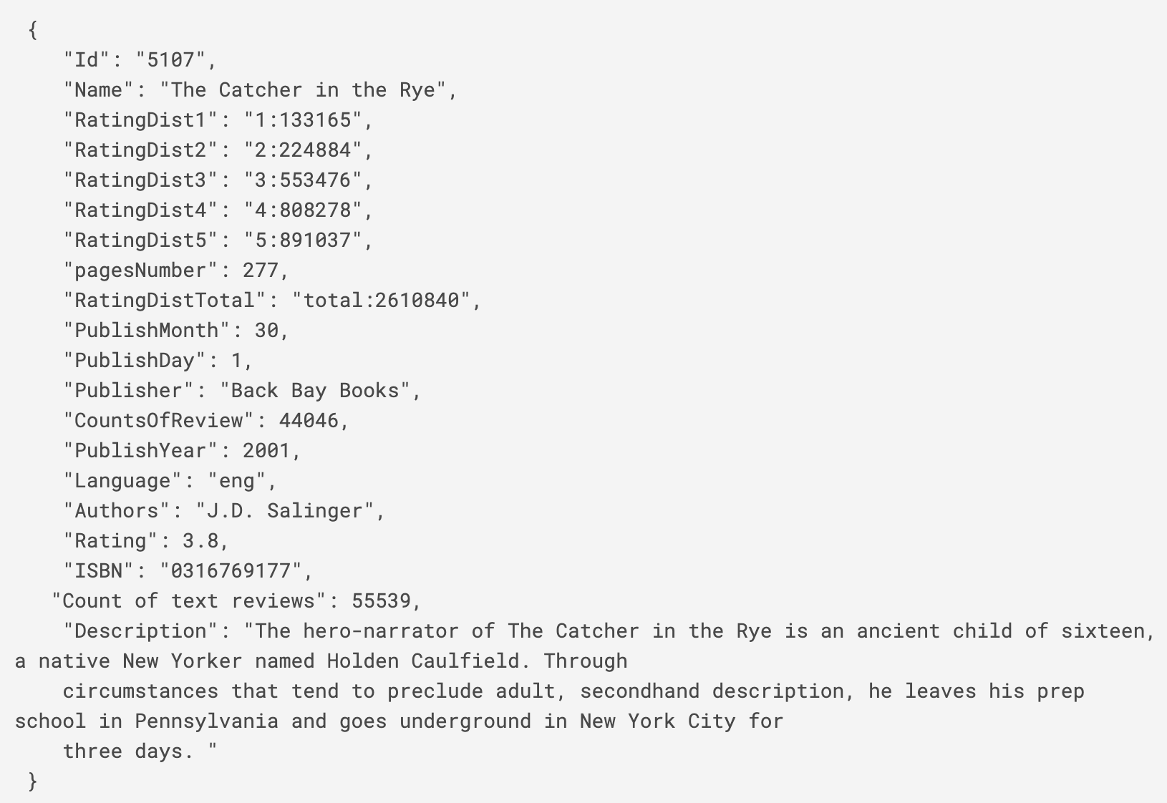
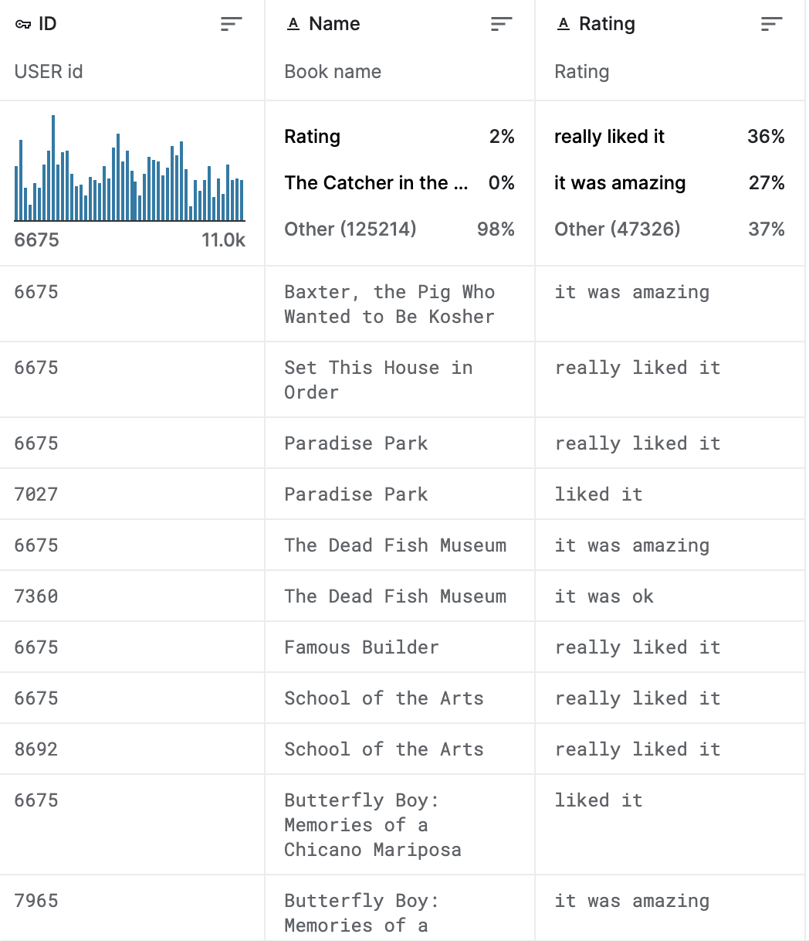
Data Ingestion
Book Sample Overview (JSON):
User Rating Sample Overview:
Highlight Challenge:
Book data are totally messed up:
Different columns amount
Different columns order
Different column name
Unstructured contents
<b>, </br>, <i>, <em>, …

Slide 5
Data Preprocessing
Data Cleaning
Remove all comma and HTML tag (<b>, < /b>, <i>, …) in text format column, like Book Name, Publisher, Description, etc
Remove all meaningless columns, like dataframe index
Table Merging
Create standard column index to reorder the columns of each data frames and fill out “None” for the lacking column(s)
Format and Merge the data frames together
Feature Engineering
Delete the redundant contents, ex: RatingDistTotal | total:30313 → RatingDist_Total | 30313
RatingDist1 | 1:257 → RatingDist_1 | 257
Combine some columns together, ex. "PublishYear"-"PublishDay"-"PublishMonth" to “PublishDate”
Change data type for PySpark schema

Slide 6
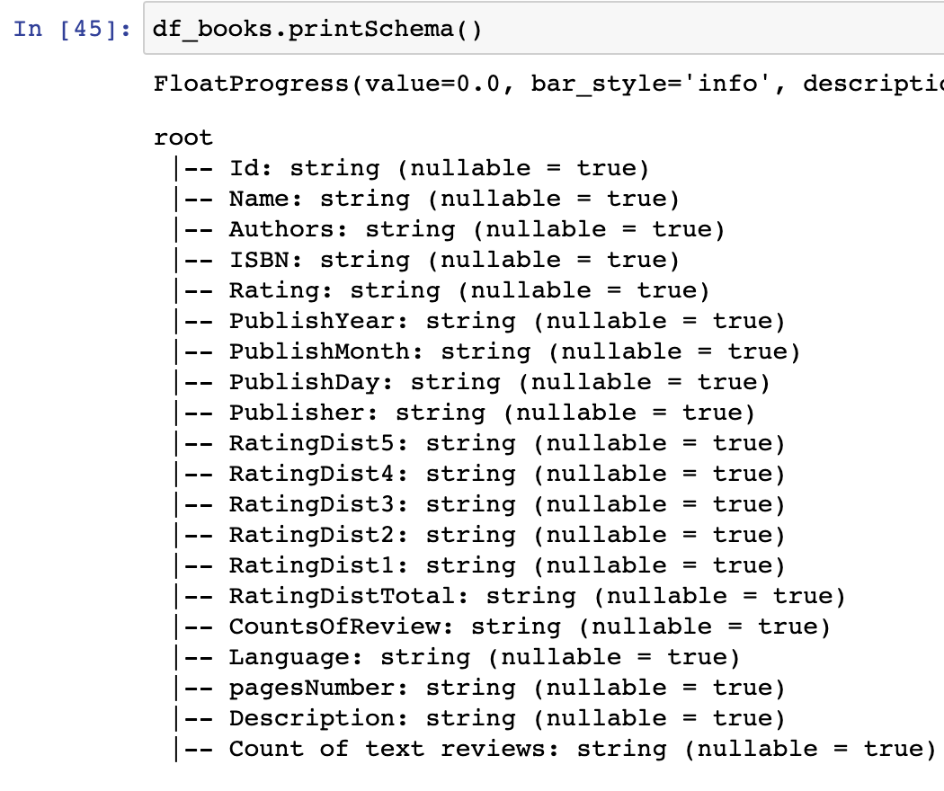
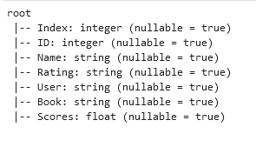
Database Design
Database Design in Hive
Table Book
Table user rating
Spark Schema for book
Spark Schema for user rating

Slide 7
Big Data Transformation
- Create Hive database and Hive tables in PySpark
- Visualization Dashboard
Simple Data Manipulation
- Data Preprocessing
- Model Building
Power BI
Upload data to
Hive
Insights
AWS S3
Python
PySpark
Hue
Recommendation System
- Database
- Query
Data Preprocessing
- Data Cleaning
- Table Merging
- Feature Engineering
- Format Schema
- Sentiment Score based on users feeling about books
Model Building
- Recommendation System
23 book.csv;
7 user rating.csv
Remove all “,” in text column
- Build Recommendation System and recommend top 10 books to user

Slide 8

Recommendation System Design
Model Group Similar user with the same books’ preference and books with liked by similar users using Embeddings layers
Sentiment score are acting as Ratings(labels for the model)
The output of embedding are multiplied using tensordot and fed into final layer for score predictions

Slide 9
Power BI Tool
ODBC Data Source
Hive to Power BI
Add Amazon/Excel ODBC Driver
Get data -> ODBC -> Tables
Input Master Node for Host and test connection
Connect ODBC to Hive

Slide 10
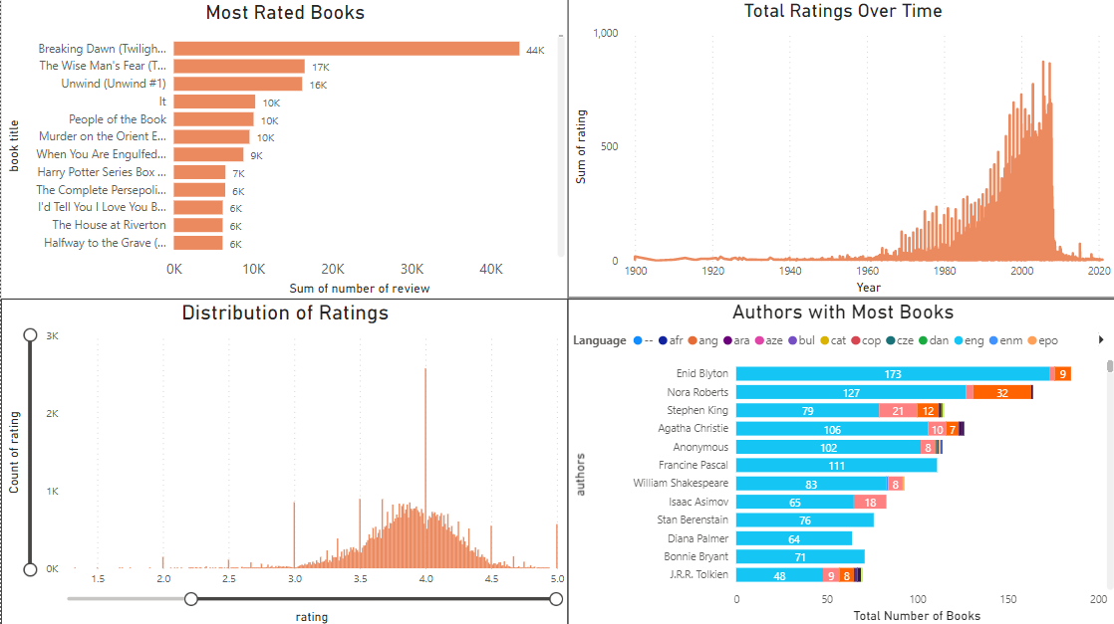
Data Insight: Pre-Modeling

Slide 11
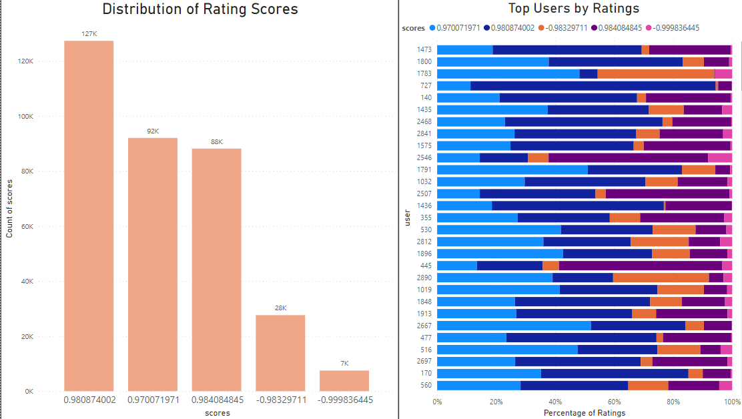
Data Insight: Post-Modeling
User Rating:
Did not like it,
It was amazing,
It was okay,
Liked it,
Really liked it
Translated to Scores:
Closer to -1 signifies to did not like it
Closer to +1 signifies to really liked it

Slide 12
Data Analysis
Most common rating by users is around 4
90% of users gave a high score on the likeness of the book while 10% of users expressed dislike of the book
Peak of reviews from mid-90s to 2008, then spikes down afterwards

Slide 13
Challenge
Data Cleaning
Book data are totally messed up:
“,” in text column make it is hard to read the data directly in PySpark
Hard to figure out where the issues come from
Inconsistent Data Schema of the input files
Different columns amount
Different columns order
Different column name
Unstructured contents
<b>, </br>, <i>, <em>, …
Infeasible to training model on the whole cluster
Figure out to train model on different nodes
Pyspark has different packages from Python to adapt for model training
Connection between ODBC and Visualization tools

Slide 14
Value for Business
01.
Personalize content for customers
02.
Competitiveness
03.
Customer Satisfaction
Predict buyer’s interest and recommend books accordingly
Allow for a more competitive business with higher probability to determine book recommendation
Increase customer satisfaction and higher retention of customers

Slide 15
Thank you!

